Slide 1
Design and Analysis of Algorithms
CS602
Lecture 6
Greedy paradigm – II
Scheduling to minimize maximum lateness
Huffman coding

Slide 2
A Job scheduling problem

Slide 3





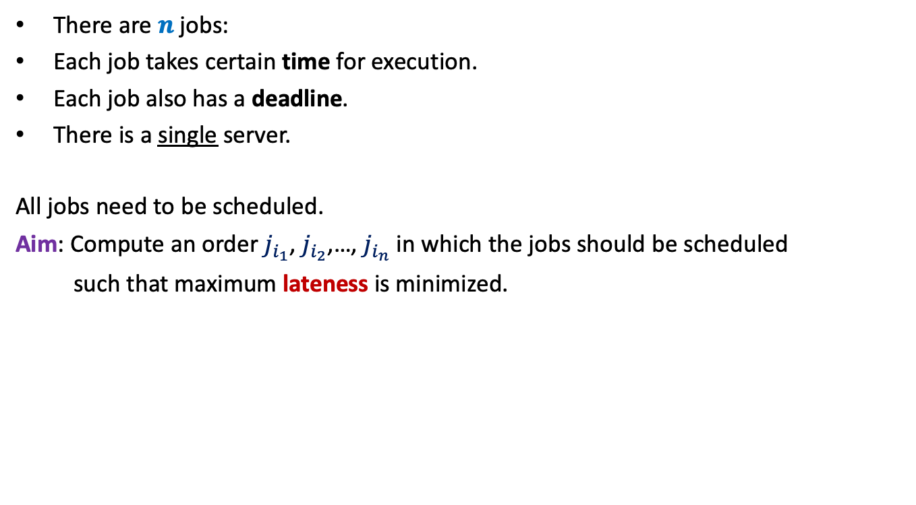








There are $n$ jobs:
Each job takes certain time for execution.
Each job also has a deadline.
There is a single server.
All jobs need to be scheduled.
Aim: Compute an order $j_{i_{1}}$, $j_{i_{2}}$,…, $j_{i_{n}}$ in which the jobs should be scheduled
such that maximum lateness is minimized.
$j_{1}$, $j_{2}$,…, $j_{n}$
Job $j_{i}$ takes $t_{i}$ time
Job $j_{i}$ has deadline $d_{i}$
$$f_{i_{k}}$$
$$d_{i_{k}}$$
$$d_{i_{k}}$$
Lateness of $j_{i_{k}}$
$$j_{i_{1}}$$
$$j_{i_{2}}$$
$$j_{i_{3}}$$
$$j_{i_{k}}$$
$$j_{i_{n}}$$
$$0$$
time

Slide 4





















Example
$$3$$
$$j_{1}$$
Lateness of $j_{1}$=
$$0$$
$$d_{1}=11$$
Lateness of $j_{2}$=
$$1.5$$
$$4.5$$
Lateness of $j_{3}$=
$$3$$
$$j_{2}$$
$$d_{2}=6$$
Maximum lateness = 3
$$5.5$$
$$j_{3}$$
$$d_{3}=10$$
$$3$$
$$7.5$$
$$13$$
$$j_{1}$$
$$j_{2}$$
$$j_{3}$$
$$0$$
time

Slide 5

Towards designing an algorithm
Each job $j_{i}$ has two parameters
Time of execution $t_{i}$
Deadline $d_{i}$
Idea 1: Schedule the jobs in the increasing order of Time of execution.
Try to prove correctness
Try to come up with a counter example

Slide 6





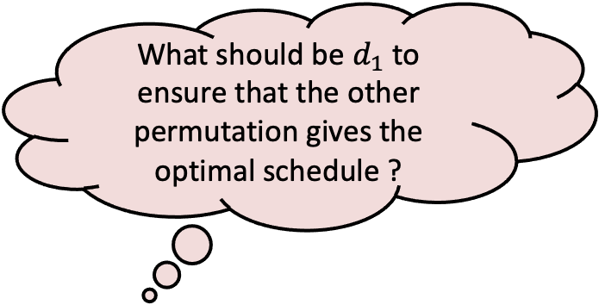


Towards designing a counterexample
Let us consider only 2 jobs.
What should be $d_{1}$ to ensure that the other permutation gives the optimal schedule ?
$$t_{1}$$
$$j_{1}$$
$$t_{2}$$
$$j_{2}$$
$$d_{2}$$
$$j_{1}$$
$$j_{2}$$
time

Slide 7

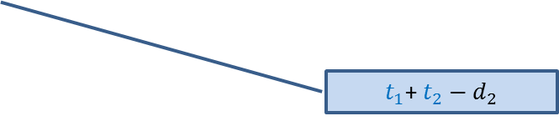

Towards designing a counterexample
Towards designing an algorithm
The job with farther deadline should be scheduled later.
the job with earlier deadline should be scheduled first.
$$t_{1}$$
This counterexample hints at a very important point as well.
$$j_{1}$$
?
$$d_{1}$$
$$t_{2}$$
$t_{1}$+ $t_{2}−d_{1}$
$$j_{2}$$
?
$$d_{2}$$
$t_{1}$+ $t_{2}−d_{2}$
$$j_{1}$$
$$j_{2}$$
time

Slide 8

How to schedule more than 2 jobs ?
Lemma:(for 2 jobs)
Scheduling ``the earlier deadline job’’ ➔ an optimal solution
Consider any schedule
time
$$0$$

Slide 9

How to schedule more than 2 jobs ?
What if the original schedule was an optimal schedule ?
How do the jobs appear in the final schedule ?
Lemma:(for 2 jobs)
Scheduling ``the earlier deadline job’’ ➔ an optimal solution
Schedule the jobs in increasing order of their deadlines.
``jobs scheduled in the increasing order of deadline’’
is an optimal schedule
In increasing order of deadlines.
Consider any schedule
time
$$0$$
Consider any pair of consecutive jobs.
If they are not scheduled in the increasing order of their deadlines,
swapping them will only minimize the maximum lateness of the schedule
By repeating this step for each pair of consecutive jobs,
we can transform the schedule into a schedule
whose maximum lateness is less than or equal to that of the original schedule.
Algorithm:
$O(n log⁡n)$ time

Slide 10
Greedy Algorithms
Unlike algorithms based on divide and conquer, the two greedy algorithms we discussed were quite adhoc (problem specific) and so was their analysis (proof of correctness)
This leads to the following question :
Does there exist any generic strategy to design and analyse Greedy algorithms ?
We shall now discuss a strategy of designing greedy algorithms that is quite generic.
To demonstrate this strategy, we address a very very nontrivial problem.

Slide 11
Greedy Algorithms
How to prove correctness ?

Slide 12
Huffman Codes
A novel and quite inspiring application of greedy algorithms

Slide 13

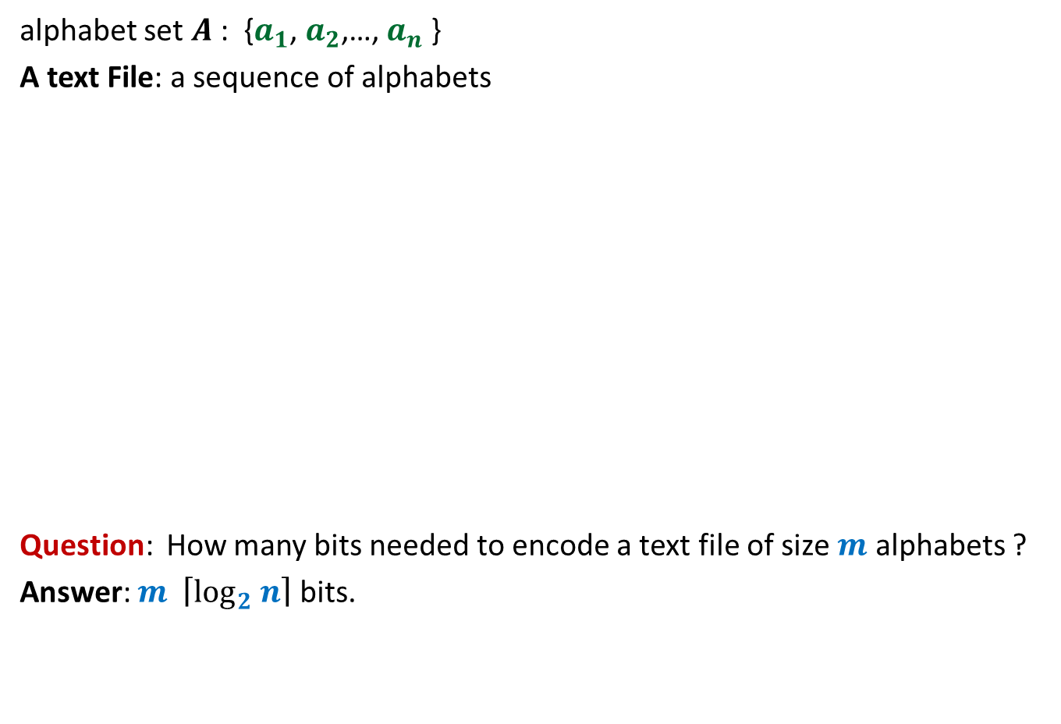
Binary coding
alphabet set $A$: {$a_{1}$, $a_{2}$,…, $a_{n}$ }
A text File: a sequence of alphabets
Question: How many bits needed to encode a text file of size $m$ alphabets ?
Answer: $m \left\lceil \log_{2} n\right\rceil$ bits.
once upon a time …………..
…………………………….
……………………………..
…………………
A text file F
Binary coding of F

Slide 14
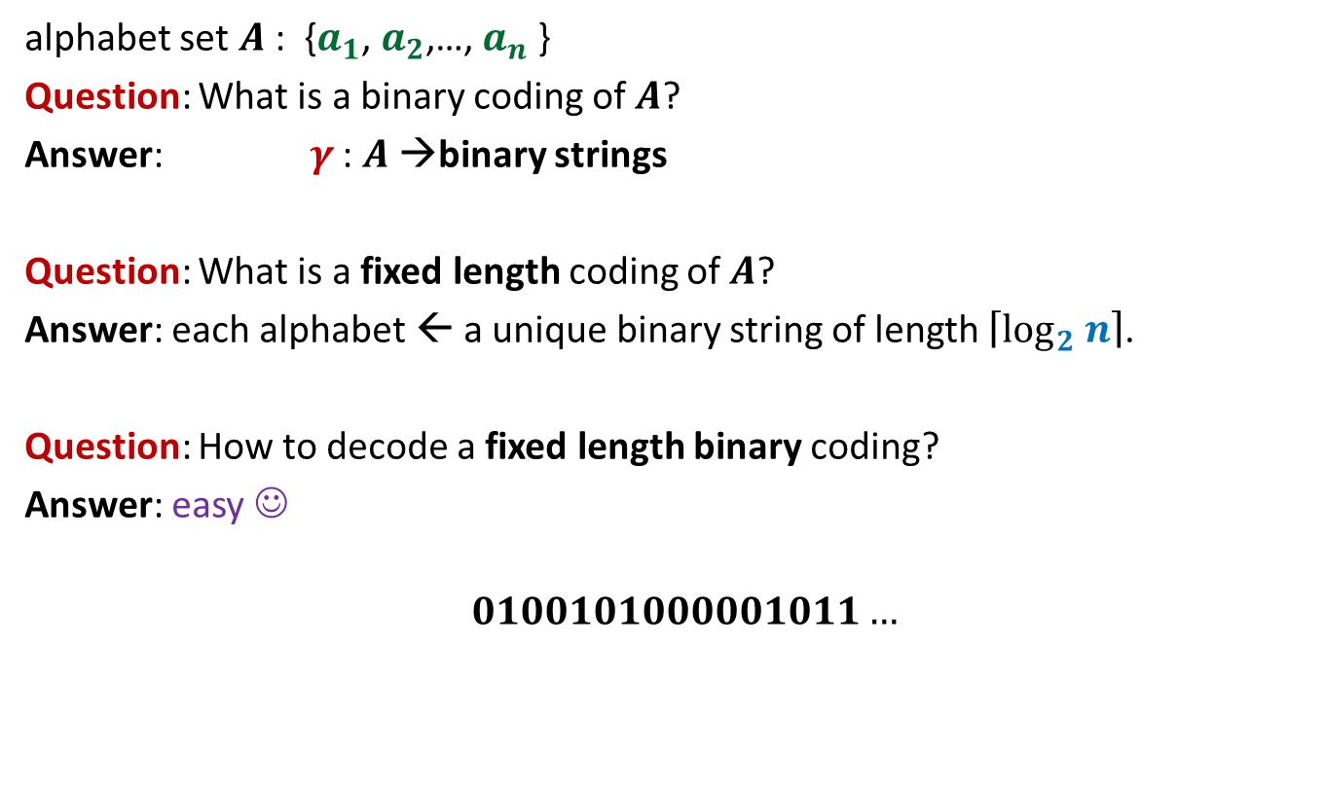
Fixed length coding
alphabet set $A$: {$a_{1}$, $a_{2}$,…, $a_{n}$ }
Question: What is a binary coding of $A$?
Answer: $γ$ : $A$→binary strings
Question: What is a fixed length coding of $A$?
Answer: each alphabet ← a unique binary string of length $\left\lceil \log_{2} n\right\rceil$.
Question: How to decode a fixed length binary coding?
Answer: easy ☺
$$0100101000001011…$$

Slide 15
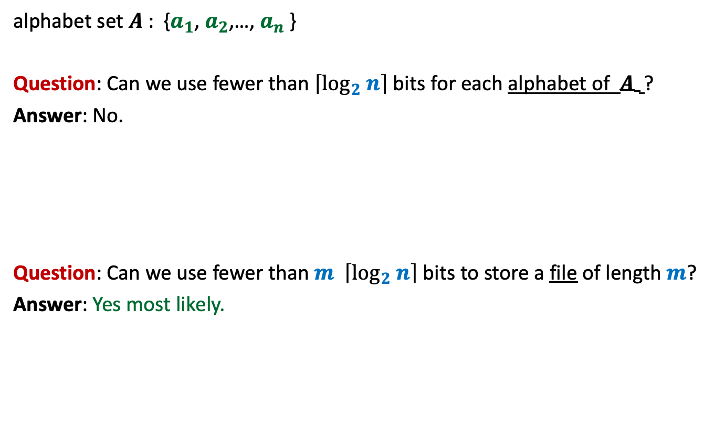
Fixed length coding
alphabet set $A$: {$a_{1}$, $a_{2}$,…, $a_{n}$ }
Question: Can we use fewer than $\left\lceil \log_{2} n\right\rceil$ bits for each alphabet of $A$ ?
Answer: No.
Question: Can we use fewer than $m \left\lceil \log_{2} n\right\rceil$ bits to store a file of length $m$?
Answer: Yes most likely.

Slide 16
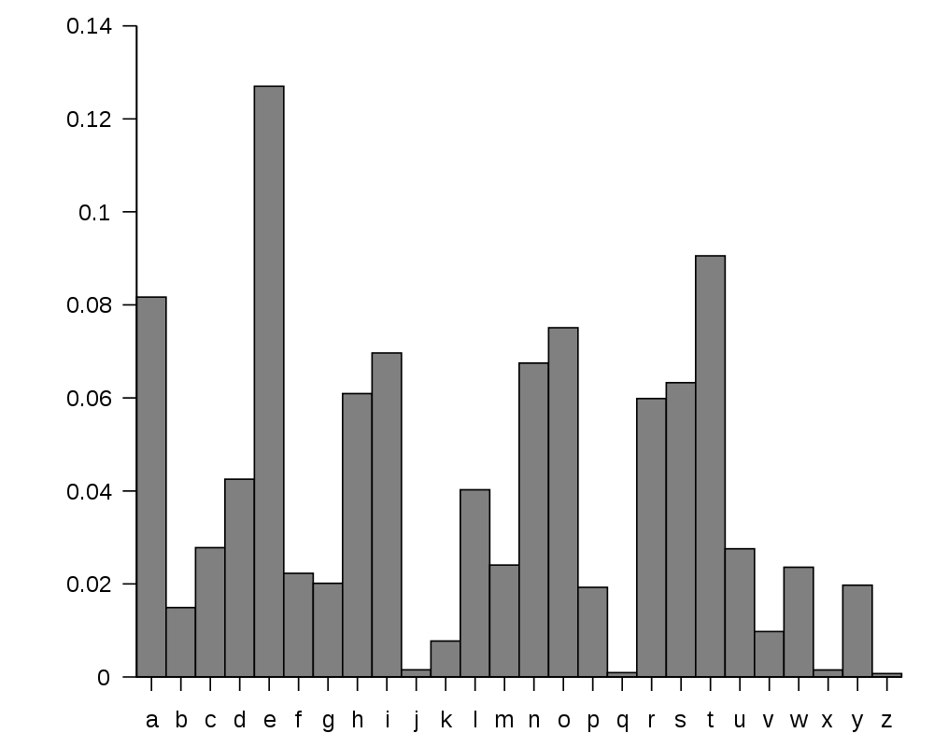
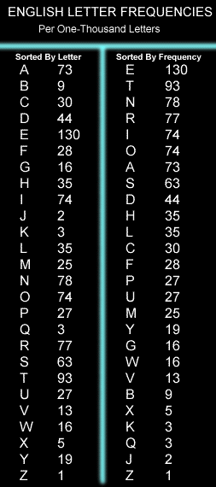
huge variation in the frequency of alphabets in a text.
http://en.wikipedia.org/wiki/Letter_frequency

Slide 17
huge variation in the frequency of alphabets in a text.
Question: How to exploit variation in the frequencies of alphabets ?
Answer:
More frequent alphabets ⬅ coding with shorter bit string
Less frequent alphabets ⬅ coding with longer bit string

Slide 18

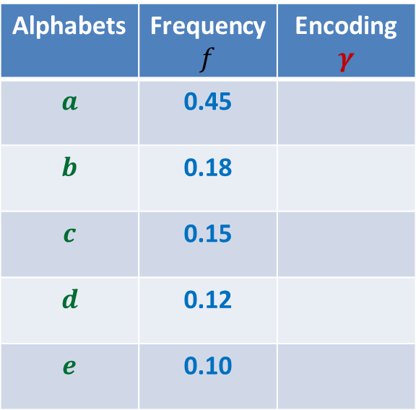

Variable length encoding
Let us think of some encoding exploiting
the variation in frequencies.
Average bit length per symbol using $γ$:
$$ABL\left(γ\right)=\sum_{x∈A}{f\left(x\right).\left|γ\left(x\right)\right|}$$
$=$ $0.45⨯1+0.18⨯2+(0.15+0.12+0.10)⨯3$
$=$ $1.92$
Question: How will you decode 01010111 ?
Answer: $abbe$ or $adae$
Question: What is the source of this ambiguity ?
Answer: $γ\left(b\right)$ is a prefix of $γ\left(d\right)$.
?
?
Alphabets | Frequency $f$ | Encoding $$γ$$
$$a$$ | 0.45
$$b$$ | 0.18
$$c$$ | 0.15
$$d$$ | 0.12
$$e$$ | 0.10
0
10
110
101
111
There is a serious problem with the $γ$encoding. Can you see?
Can we fix it ?

Slide 19

Variable length encoding
Average bit length per alphabet using $γ$:
$$ABL\left(γ\right)=\sum_{x∈A}{f\left(x\right).\left|γ\left(x\right)\right|}$$
$=$ $0.45⨯1+0.18⨯3+(0.15+0.12+0.10)⨯3$
$=$ $2.1$
Alphabets | Frequency $f$ | Encoding $$γ$$
$$a$$ | 0.45
$$b$$ | 0.18
$$c$$ | 0.15
$$d$$ | 0.12
$$e$$ | 0.10
0
100
110
101
111

Slide 20
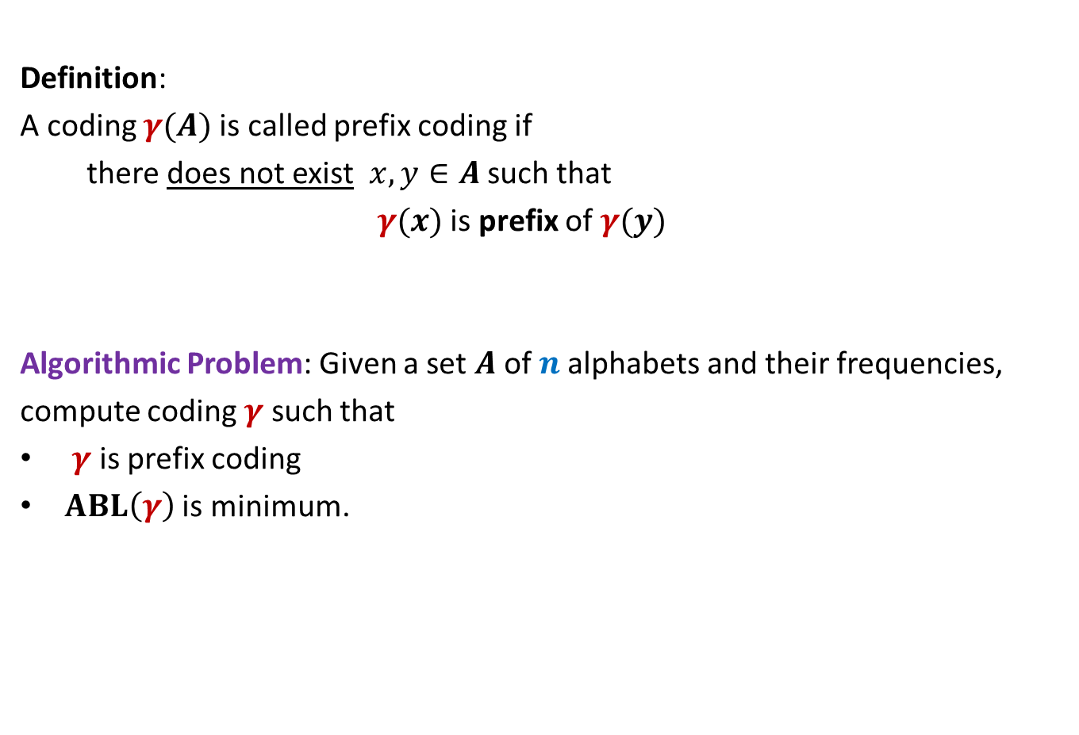
Prefix Coding
Definition:
A coding $γ(A)$is called prefix coding if
there does not exist $x,y∈A$ such that
$γ(x)$ is prefix of $γ(y)$
Algorithmic Problem: Given a set $A$of $n$alphabets and their frequencies,
compute coding $γ$ such that
$γ$ is prefix coding
$ABL\left(γ\right)$ is minimum.

Slide 21

The challenge of the problem
Among all possible binary coding of $A$, how to find the optimal prefix coding ?
It looks too complex ☹ because …
it is too difficult to see any structure underlying the set of binary strings

Slide 22
The novel idea of Huffman
?
0
1
0
1
0
1
Binary coding
Labeled
Binary tree

Slide 23
A labeled binary tree
nodes → ?
Code of an alphabet = ?
0
1
0,
00,
001
01,
1,
10,
100,
101
0
1
0
1
0
1
alphabets
Label of path from root

Slide 24
prefix codes and labeled Binary tree

Slide 25
A labeled binary tree
Consider a prefix code 101
0
1
1
0
Visualize a binary tree for the prefix code ?
0
1

Slide 26
A labeled binary tree
0
1
0
1
1
0
0
1
0
1
0
1
0
1

Slide 27
A labeled binary tree
leaf nodes → alphabets
Code of an alphabet =
0
1
01,
001,
0000,
11,
100,
10110,
10111
0
1
1
0
0
1
0
1
0
1
0
1
Label of path from root

Slide 28
Homework
Design an algorithm that given a prefix coding for a set of alphabets, builds the corresponding labeled binary tree.
The algorithm is sketched on the following slide.

Slide 29

Prefix Coding
Question:
How to build the labeled tree for a prefix code ?
Alphabets | Frequency $f$ | Encoding $$γ$$
$$a$$ | 0.45
$$b$$ | 0.18
$$c$$ | 0.15
$$d$$ | 0.12
$$e$$ | 0.10
0
{0, 100, 101, 110, 111}
0
1
100
110
{00,01,10,11}
$$a$$
101
111

Slide 30
Prefix Coding
Question:
How to build the labeled tree for a prefix code ?
Alphabets | Frequency $f$ | Encoding $$γ$$
$$a$$ | 0.45
$$b$$ | 0.18
$$c$$ | 0.15
$$d$$ | 0.12
$$e$$ | 0.10
0
0
1
100
110
0
1
$$a$$
101
{0,1}
{0,1}
111

Slide 31




Prefix Coding
Question:
How to build the labeled tree for a prefix code ?
Alphabets | Frequency $f$ | Encoding $$γ$$
$$a$$ | 0.45
$$b$$ | 0.18
$$c$$ | 0.15
$$d$$ | 0.12
$$e$$ | 0.10
0
0
1
100
110
0
1
$$a$$
101
0
1
0
1
111
$$b$$
$$d$$
$$c$$
$$e$$

Slide 32
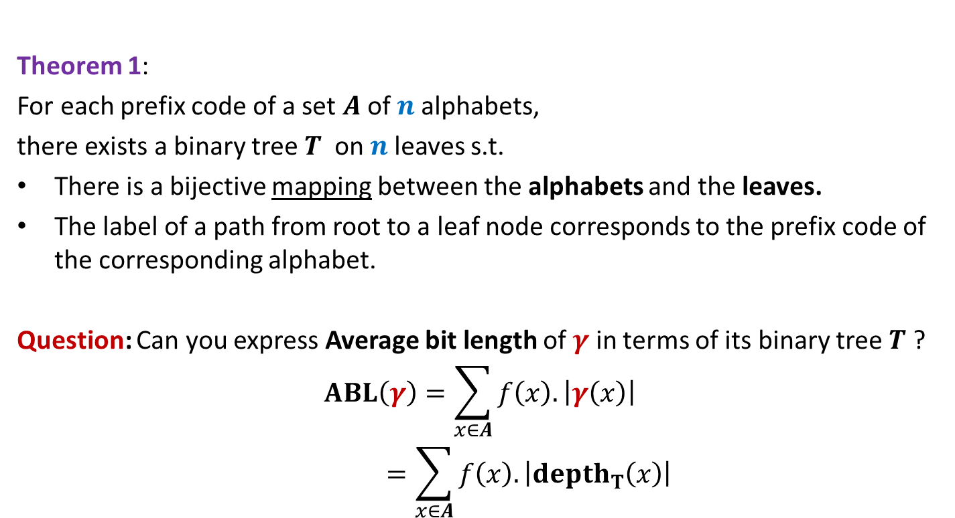
Theorem 1:
For each prefix code of a set $A$of $n$alphabets,
there exists a binary tree$T$ on $n$leaves s.t.
There is a bijective mapping between the alphabets and the leaves.
The label of a path from root to a leaf node corresponds to the prefix code of the corresponding alphabet.
Question: Can you express Average bit length of $γ$ in terms of its binary tree $T$ ?
$$ABL\left(γ\right)=\sum_{x∈A}{f\left(x\right).\left|γ\left(x\right)\right|}$$
$$=\sum_{x∈A}{f\left(x\right).\left|depth_{T}\left(x\right)\right|}$$

Slide 33
Finding the labeled binary tree for
the optimal prefix codes

Slide 34
Homework
Imagine the labeled Binary tree corresponding to optimal prefix coding.
Can you make any inference about the node corresponding to the most frequent alphabet in this tree ?
Can you make any inference about the node corresponding to the least frequent alphabet in this tree ?
You must justify your inference, if any.
Please submit your answer in the next lecture. ☺

